Slide 1

App Gateways
Application Gateways
Rainer Stropek
software architects gmbh
Web
Mail
Twitter
http://www.timecockpit.com
rainer@timecockpit.com
@rstropek
for Microservices

Slide 2
Agenda
Je mehr Microservices es werden, desto dringender brauchen Sie eine verlässliche und sichere Routinglösung, die den Traffic aus dem Web zum richtigen Endpunkt schickt. Rainer Stropek, langjähriger Azure MVP und MS Regional Director, startet in seiner Session mit einem Überblick über die Rolle von Application-Gateways in Microservices-Architekturen. Welche Aufgaben haben Application-Gateways in Verbindung mit Microservices? Welche Vorteile fügt ein professionelles Application-Gateway dem Microservices-Ansatz hinzu? Nach dieser Einleitung zeigt Rainer Demos mit dem OSS-Tool nginx und im Vergleich dazu den PaaS-Dienst Azure Application Gateway.

Slide 3
Why?

Slide 4
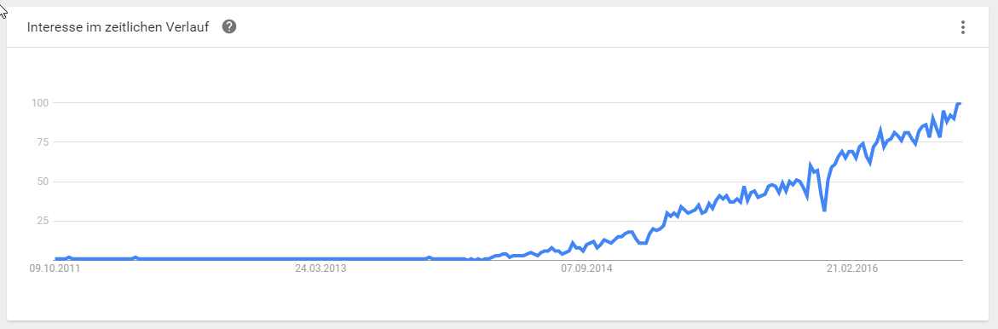
Microservices are currently hot!
Source: https://www.google.com/trends/explore?q=Microservices, 2016-10-03

Slide 5
What are Microservices?
Small, autonomous services working together
Autonomous = deploy changes without affecting others
Technology- and platform-agnostic APIs
E.g. RESTful Web APIs, Queues, Topics/Subscriptions, Events, Webhooks, etc.
E.g. HTTP/REST, OData, GraphQL, OpenID Connect
See also https://en.wikipedia.org/wiki/Microservices

Slide 6
Monolith to Microservices
ERP
HR
Notification
REST API
ERP
HR
EDI
Apps
Accounting
Payments
PLM
Accounting
Web UI
CRM
Doc. Mgmt.
Web UI
Apps
SCM
CRM
Ext. Partners
SCM
Rating
PLM
…

Slide 7
Challenges and Goals

Slide 8
Challenges and Goals
Simplify Web API
Single, nicely designed URL scheme
Example: Microsoft Graph

Slide 9
Simplify Web API
HR
https://hr.api.acme.com/
/hr/*
/acc/*
https://acc.us.acme.com/
Accounting
Gateway
/crm/*
CRM
https://api.acme.com
https://crm.azurewebsites.net/
SCM
…

Slide 10
Challenges and Goals
Simplify Web API
Single, nicely designed URL scheme
Example: Microsoft Graph
Rewrite Requests
E.g. add/remove headers
Add Security Features
Terminate HTTPS
Validate secrets (e.g. JWT with OpenID Connect, API keys)
Building a Trusted Subsystem

Slide 11
Security Features
Trusted Subsystem
HR
Gateway
http://10.0.0.1/ http://10.0.0.2/
https://api.acme.com
DB
Microservice A
Microservice B

Slide 12
Challenges and Goals
Reduce number of requests
Client’s needs vs. fine-grained microservices
Performance over slow networks
Translate Protocols
External HTTP RESTful Web API
Internal AMQP Topic/Subscription

Slide 13
Security Features
RESTful Web API on https://api.acme.com
Gateway
AMQP
HR
CreateUser
Result
Webhook

Slide 14
Challenges and Goals
Reduce number of requests
Client’s needs vs. fine-grained microservices
Performance over slow networks
Translate Protocols
External HTTP RESTful Web API
Internal AMQP Topic/Subscription
Caching
Reduce load on backend servers

Slide 15
Challenges and Goals
Handle downstream errors
Return default values or cached value in case of unavailable microservices
Throttling, Quotas
Overuse, DoS

Slide 16
Solutions

Slide 17
Solutions
PaaS in Azure
Azure Application Gateway (optionally with Web Application Firewall)
Azure API Management (no demo in this session)
Azure Functions Proxies (Preview)
Dedicated products
We will discuss nginx
Custom development
Node.js, .NET Core
Serverless „Meta-Microservices“
Lua/JavaScript with nginx

Slide 18
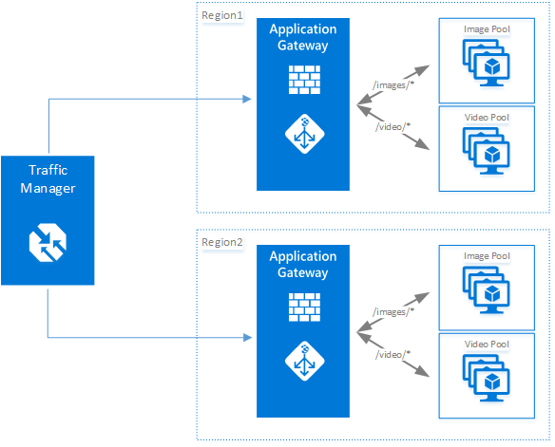
Azure Application Gateway
Layer 7 Load Balancing Capabilities
HTTP Load Balancing (optional cookie-based session affinity)
Websockets support
SSL offload
URL-based routing
Multi-site routing
Health monitoring
Optional WAF
Procs/cons
☺ Good for load-balancing in IaaS
☹ Limited functionality
☹ Rather slow
☹ Not only choice for non-trivial Microservices environments
Image Source: https://docs.microsoft.com/en-us/azure/application-gateway/application-gateway-introduction

Slide 19
Application Gateway
Configuration
Size, count
Backend servers
Rule configuration (basic, path-based)

Slide 20
NGINX
OSS and commercial license (NGINX Plus)
Different feature sets (compare)
Pros/cons
☺ Rich functionality
☺ Programmable (Lua, JavaScript)
☺ Light-weight fast (see demo with nginx on Alpine later)
☹ IaaS → you have to care for it yourself

Slide 21
Config Example
events {}
http {
server {
location /crm/ {
proxy_pass http://app-gateway-hr.azurewebsites.net;
rewrite /crm/(.*) /$1 break;
proxy_buffering off;
proxy_set_header Host $proxy_host;
proxy_set_header X-API-KEY my-api-key;
}
location /hr/ {
proxy_pass http://app-gateway-hr.azurewebsites.net;
rewrite /hr/(.*) /api/$1 break;
proxy_buffering off;
proxy_set_header Host $proxy_host;
proxy_set_header X-API-KEY my-hr-key;
}
}
}
docker run -d -p 8080:80 \
-v C:\temp\AppGateway\nginx\nginx.conf:/etc/nginx/nginx.conf:ro \
nginx:alpine

Slide 22
NGINX
NGINX in Docker
App Service backends

Slide 23
Azure Functions Proxies
Part of Azure Functions (=Serverless Microservices)
Routing not limited to Azure Functions
Pros/cons
☺ Easy to use
☺ Easy to configure (also programmatically
☺ PaaS
☺ Pay what you need (per execution)
☹ Limited functionality
See also https://docs.microsoft.com/en-us/azure/azure-functions/functions-proxies

Slide 24
Functions Proxy
{
"$schema": "http://json.schemastore.org/proxies",
"proxies": {
"CRM": {
"matchCondition": {
"route": "/crm/{*restOfPath}"
},
"backendUri":
"https://app-gateway-crm.azurewebsites.net/{restOfPath}",
"requestOverrides": {
"backend.request.headers.X-API-KEY": "my-api-key"
}
},
"HR - Get Employee": {
"matchCondition": {
"route": "/hr/employees/{eid}",
"methods": [
"GET"
]
},
"backendUri":
"https://app-gateway-hr.azurewebsites.net/findEmp",
"requestOverrides": {
"backend.request.method": "post",
"backend.request.querystring.eid": "{eid}"
}
}
}
}

Slide 25
Functions Proxy
Portal configuration
Advanced configuration
In Code

Slide 26
Summary

Slide 27
Summary
Inevitable in non-trivial microservice environments
More than just a reverse proxy
E.g. protocol translation
Dynamic configuration
Reflect changes in microservices environment
Can be combined with DNS-based traffic manager
For cross-datacenter distribution
Critical component
Must be highly available
Performance matters

Slide 28
Q&A
Time cockpit eLearning Library
Rainer Stropek
software architects gmbh
Mail Web Twitter
rainer@timecockpit.com http://www.timecockpit.com @rstropek
Thank your for coming!

